Slide 1
1.4 Performance Metrics & Feedback Loops
THIS WILL NOT BE IN PPT FORM. THIS IS COPY FOR THE DOWNLOADABLE ASSET MODULE.

Slide 2
Performance Metrics & Feedback Loops: Using Data to Sustain Improvement
The purpose of this module is to show how programs can measure the impact of peer roles and use structured feedback loops to continuously improve. Metrics tell us what is happening; feedback loops help us refine how we respond. Together, they ensure that peer integration is not a one-time initiative but an ongoing cycle of accountability and learning.

Slide 3
Why Metrics & Feedback Matter
Without metrics, teams cannot know if peer integration is improving access or engagement. Without feedback loops, metrics become static reports rather than living tools for change. Tracking and refining ensures:
Transparency and accountability.
Visibility of peer contributions.
Early detection of problems.
Continuous improvement through data-informed decisions.

Slide 4
Core Metrics to Track
The most useful metrics fall into four categories:
Peer-Driven Outcomes
  Number of clients re-engaged after outreach.
  Group participation and retention rates.
  Client progress on recovery goals (non-clinical measures like housing stability, employment, or self-management).
Engagement Rates
  No-show reduction (e.g., peers calling missed appointments).
  Days from referral to intake/first appointment.
  Client retention over 3–6 months.
Task Completion
  Percentage of delegable tasks reassigned and completed (from delegation matrix).
  Documentation timeliness (peer notes, activity logs).
  Supervision follow-up items closed within timeframe.
Participant Satisfaction
  Consumer satisfaction surveys (quarterly).
  Peer/staff satisfaction and burnout surveys.
  Feedback on clarity of roles and team collaboration.

Slide 5
In addition to program-wide metrics, it’s also important to set role-based productivity benchmarks for clinicians, peers, and supervisors. These benchmarks ensure each role is operating at top-of-license and allow teams to link daily performance with broader program outcomes.

Slide 6
Productivity Dashboards and Benchmarks
Designing Role-Based Dashboards to Track Capacity, Efficiency, and Improvement
Sample Dashboard
Role | Key Productivity Metrics | Benchmark Goal
Clinician | Billable hours per week, no-show rate, time-to-doc closure | ≥26 billable hrs, <15% no-show
Peer Specialist | Engagements per week, handoff follow-through | ≥10 per week
Supervisor | Supervision completed, QA audits per month | 90%+ completion

Slide 7
Feedback Loops: Making Metrics Actionable
Collecting data is only half the work. Programs must create feedback loops where staff review metrics, reflect, and refine processes. Feedback loops should include:
Debriefs in Supervision: Supervisors and peers review metrics in 1:1s and group supervision.
Team Huddles: Quick checks on key metrics (e.g., engagement, no-shows).
Monthly Reviews: Dashboards and reports presented to leadership and teams.
Quarterly Refinement: Structured sessions where data drives updates to protocols, delegation, or training.
This creates a culture of accountability and learning.

Slide 8
Case Example #1: Metrics in Action
At a behavioral health program, leaders tracked no-show rates, peer outreach, and documentation compliance monthly. When no-show rates stopped improving, they used supervision debriefs and peer focus groups to uncover the barrier: clients weren’t answering phone calls. The team shifted to text outreach and portal reminders. Within two months, re-engagement rates improved by 15%, and client satisfaction scores increased. Metrics highlighted the issue; the feedback loop created the solution.

Slide 9
Case Example #2: Using Satisfaction Metrics to Refine Peer Roles
Problem:
A community behavioral health program was tracking engagement and task completion but had not incorporated client or staff satisfaction surveys. Despite strong re-engagement numbers, staff turnover was increasing, and clients reported mixed experiences with group sessions.
Action:
The program introduced quarterly satisfaction surveys for both clients and peers. Feedback revealed that peers wanted more structured supervision, and clients valued one-on-one coaching more than large group facilitation. Supervisors brought these findings into monthly debriefs.
Result:
Supervision frequency increased, group size was reduced, and more peer hours were shifted to one-on-one sessions. Within six months, peer satisfaction rose from 68% to 86%, staff turnover decreased, and client satisfaction improved by 15%.

Slide 10
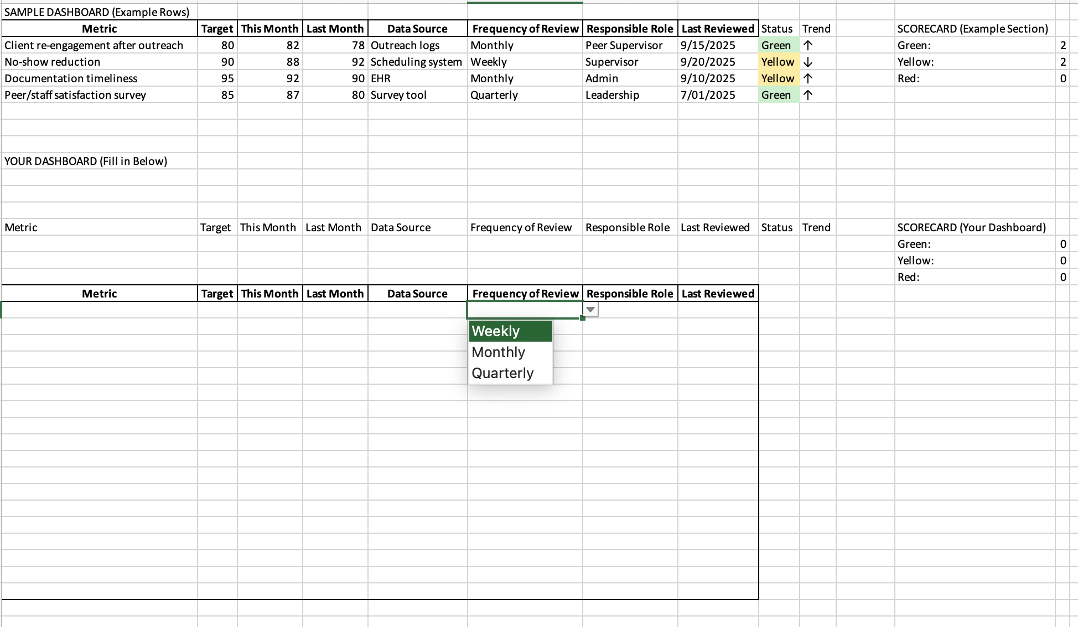
Peer Metrics & Feedback Dashboard Template
Rachel drafted download based on stuarts copy (shown below) full file in folder for review

Slide 11
Dashboards bring peer metrics to life by showing results at a glance. Here we’ve organized outcomes into four categories — peer-driven results, engagement, task completion, and satisfaction. The color coding and trend arrows make it easy to see where we’re meeting goals, where we’re close, and where we need to refine our protocols. This kind of visual tool helps teams connect data to action in real time

Slide 12
Peer Metrics & Feedback Dashboard
Category | Metric | Current Value | Goal/Target | Trend
Peer-Driven Outcomes | Clients re-engaged after outreach | 78% 🟢 | 75%+ | ↑ 🟢
 | Group participation retention | 85% 🟢 | 80%+ | → 🟡
Engagement | No-show rate | 11% 🟡 | <10% | ↓ 🔴
 | Avg. days from referral to intake | 9 days 🟡 | <7 days | ↓ 🔴
Task Completion | Delegable tasks reassigned | 72% 🟡 | 80%+ | ↑ 🟢
 | Documentation completed within 24 hrs | 96% 🟢 | 95%+ | ↑ 🟢
Satisfaction | Client satisfaction (quarterly survey) | 88% 🟢 | 85%+ | → 🟡
 | Peer/staff satisfaction (internal survey) | 82% 🟡 | 85%+ | ↑ 🟢

Slide 13
Key Takeaways
Metrics demonstrate the value of peers and highlight opportunities for improvement.
Core metrics include outcomes, engagement, task completion, and satisfaction.
Feedback loops ensure data is used to refine practice, not just report performance.
Case examples show how feedback loops can uncover barriers and drive rapid change.

