Slide 1

February 4, 2026
1:00 PM – 2:00 PM ET

Slide 2
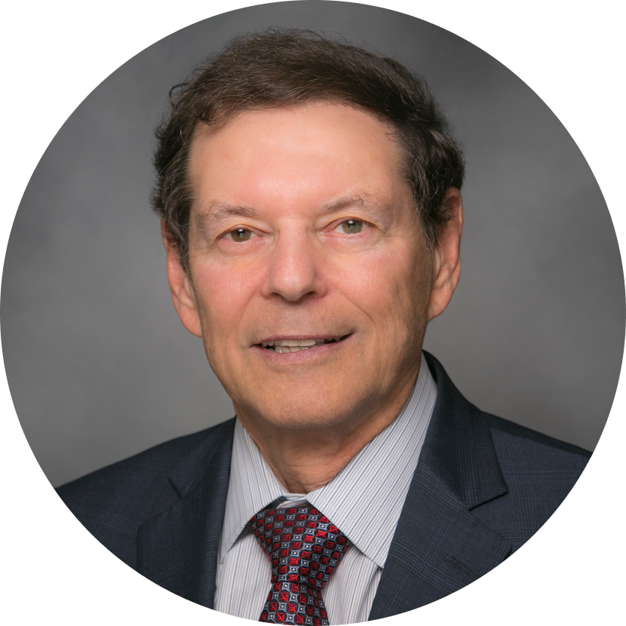

Stuart Buttlaire, Ph.D.
Christy Dye, MPH
Formerly Chief Executive Officer, Partners In Recovery, LLC
Vice President Of Clinical
Excellence & Leadership
OPEN MINDS
Live Session:
Top of License Practice, Workflow Mapping & Bottleneck Identification
1

Slide 3
POLL
Where is your biggest workflow bottleneck today?
Front Door/Intake Process
Clinical Approvals/Sign Off Needed
Care Coordination/Care Handoffs
Documentation
2

Slide 4
POLL
Which role spends the most time working below their license/credentials?
Psychiatrists and Nurse Practitioners
Nursing
Care Coordinators
Peer Support
3

Slide 5
Top-of-License Practice
Top-of-License practice means aligning work to training, licensure, and judgment level—not simply redistributing tasks.
Common Misalignment Patterns
Psychiatrists completing routine refills or documentation
Licensed clinicians performing administrative or clerical work
Peers underutilized or limited to informal support roles
4

Slide 6
What High-Performing Teams Do Differently
Define decision rights vs. task execution
Use protocols and standing orders to support delegation
Reserve licensed clinician time for diagnosis, treatment planning, and complex decisions
Key Takeaway The goal isn’t to shift work—it’s to stop doing low-value work entirely.
Why It Matters
Improves access without adding staff
Reduces burnout and role strain
Increases clinical capacity and staff satisfaction
5

Slide 7
Workflow Mapping & Analysis
Workflow Mapping is the process of making invisible work visible.
Why Map Workflows?
Understand how work actually happens—not how it’s intended to happen
Identify delays, rework, and unnecessary handoffs
Surface mismatches between role, task, and accountability
6

Slide 8
Workflow Mapping & Analysis (Continued)
What Teams Commonly Discover
What to Map
Intake and referral flow (“front door”)
Medication management and refill processes
Documentation, follow-up, and care coordination
Work sitting in in-boxes with no owner
Sequential handoffs that could occur in parallel
Staff waiting for approvals that add no clinical value
Clients waiting for the next step
Key Takeaway You can’t fix what you haven’t mapped.
7

Slide 9
Bottlenecks - From Awareness to Action
What Bottlenecks Look Like
Common Root Causes
Backlogs at intake or scheduling
Medication refills delayed due to limited RN availability
Escalation to psychiatrists for routine issues
Wait lists
Staff chasing information
Unclear authority or escalation rules
Over-reliance on licensed staff for routine tasks
Sequential processes where parallel work is possible
8

Slide 10
Resolution: Distinguish Value-Added Steps From Waste
Value-added steps:
Waste includes:
Directly benefit the client
Improve safety or outcomes
Are required for compliance
Duplicate work
Rework
Waiting
Unnecessary approvals
Steps no one can explain
Many steps exist only to compensate for earlier design flaws
Key Takeaway Not every step deserves to survive redesign.
9

Slide 11
Bottlenecks - From Awareness to Action (Continued)
High-Impact Fixes
Clarify who decides, who acts, and when
Shift routine clinical tasks using protocols
Run intake, eligibility, and engagement in parallel
Use checklists and warm handoff scripts
Key Takeaway Bottlenecks are predictable — and therefore fixable.
Results
Faster access
Fewer errors and rework
Less staff frustration and burnout
10

Slide 12
Case Study: Redesigning Intake & Medication Workflow In Outpatient Behavioral Health
Workflow Issues Identified
Changes Implemented
Setting
Psychiatrists handling routine refills
RNs doing EHR uploads and clerical tasks
Intake moving sequentially with multiple handoffs
Psychiatrists focused on diagnostics and med changes
RNs managed protocol-driven refills and labs
Admin staff handled documentation and uploads
Intake, eligibility, and engagement occurred in parallel
Multi-site outpatient MH/SUD provider
Long wait times, staff burnout, high no-show rates
11

Slide 13
Case Study: A Workflow Fix With Results
Results (within 90 days)
25–30% reduction in time to first visit
Increased psychiatrist capacity (≈1+ new patient/day)
Reduced reported staff burnout
Improved early engagement and follow-through
Key Takeaway Access improves when work is redesigned – not just when staff are added.
12

