Slide 1

Financial Management of Prospective Payment:
The Value of Budgeting & Forecasting

Slide 2


Deanne Cornette, MHA, GPC
Raymond Wolfe, JD
Senior Associate
Formerly VP of Strategic Development
Tampa Family Health Centers
Senior Associate
Formerly Chief Operating Officer, Pittsburgh Mercy Health System
Live Session:
The Value of Budgeting and Forecasting
1

Slide 3
POLL #1
How would you describe your organization’s current budgeting approach?
A. Primarily an annual static budget with limited updates during the year B. Annual budget with occasional forecast revisions C. Rolling forecast updated quarterly or more frequently D. Fully driver-based or scenario-based financial planning model
1

Slide 4
Poll #2
How would you describe the collaboration between your finance and clinical leadership teams in budgeting and forecasting decisions?
A. Finance largely develops budgets independently B. Finance consults clinical leadership periodically C. Finance and clinical leaders jointly review forecasts and variances D. Integrated planning model with shared KPIs and scenario planning
2

Slide 5

CCBHC Prospective Payment
CCBHC providers often find revenue increases under the prospective payment model, but it requires a stricter approach and financial discipline to be successful.
PPS will pay you for new programs and services, salary increases, and improvements of many sorts BEFORE you introduce them.
But It Has To Be In The Budget!
3

Slide 6

Two Sides To The Coin - With Opportunity Comes Risk
You are paid a single rate based on the financial forecasts you provided 2 years ago.
While there may be inflation adjustments, if something is left out the result will be under-payment or no payment at all.
No adjustments allowed until the next cost report cycle.
4

Slide 7

The Evolution of Budgeting
From Static to Rolling Forecasts
Scenario Planning as a Core Discipline
Driver-based budgeting models where appropriate
Most Importantly: Supporting Dynamic Communication and Cross-Learning Between Clinical and Financial Teams
The through-line across all of this is a philosophical shift: Budgeting is no longer treated as an annual exercise that’s set in stone for a year, but as a living document designed to accommodate the unknown.
5

Slide 8

CCBHC Magnifies The Need For Financial Planning and Analytics (FP&A)
Rather than presenting evidence of a financial crisis that occurred 60 days ago to a group of leaders who have no planned response, Financial Planning & Analytics models help organizations anticipate change and intervene early.
Financial sustainability depends less on cost-cutting and more on disciplined forecasting, informed portfolio decisions, and leadership teams that can navigate uncertainty with speed and clarity.
Organizational goals are codified into budgets, forecasts, and measurable financial targets that are operationally grounded.
Based on each organization’s financial profile, key indicators can be selected and monitored for specific risks.
Through variance analysis, scenario modeling, and trend monitoring, FP&A identifies risks before they escalate to a crisis, giving leaders time to adjust course. It utilizes early warning KPI and tracks trends.
6

Slide 9
7 Foundational Elements Of FP&A
CCBHC mandates a clearly distinct service line definition and budgeting process with a mirrored leadership hierarchy. Granular, site-based detail is developed for each service line.
Trained, dedicated finance department staffing with sound communication skills.
A strong data set for cost accounting, capacity limits, and productivity standards.
A forecasting model that projects forward based on historical trends or recent changes.
Scenario planning for most likely high-risk events.
A rapid accounting cycle close, and
Cross-departmental communication and planning, incorporating an integrated CQI model.
7

Slide 10
Forecasting Models
Forecasting Logistics
Income statement, cash flow, and KPI forecasts….
Income statement, cash flow, and KPI forecasts….
…Based on seasonality, rolling averages and driver change methods…
…And addressed through thoughtful brainstorming
8

Slide 11
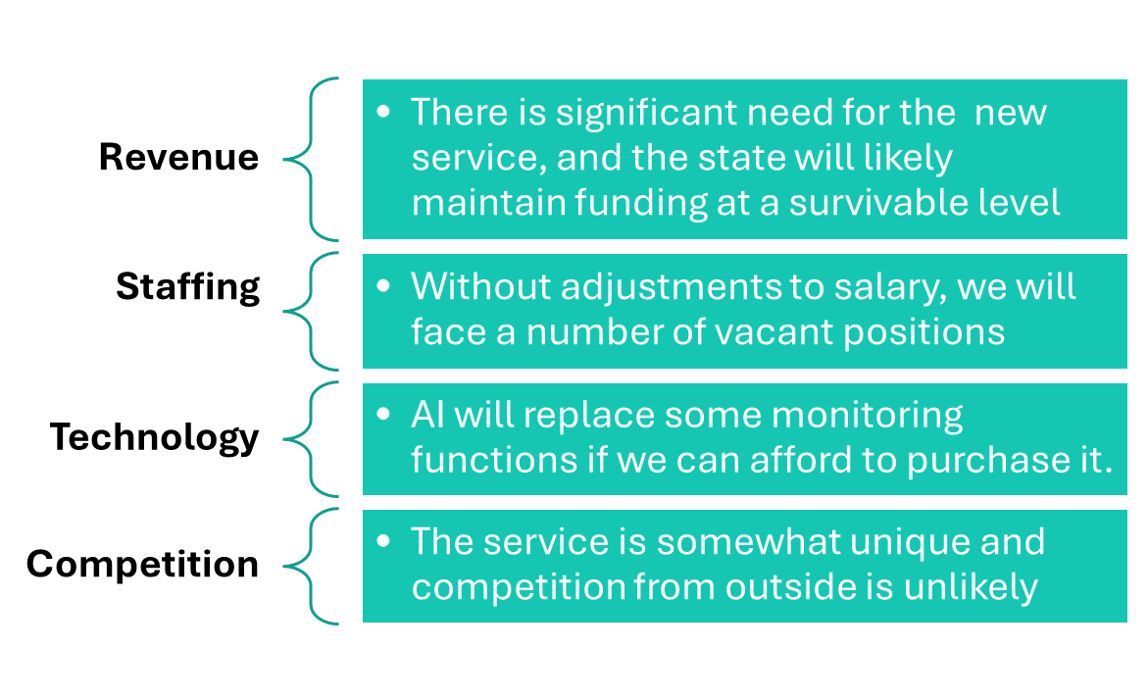
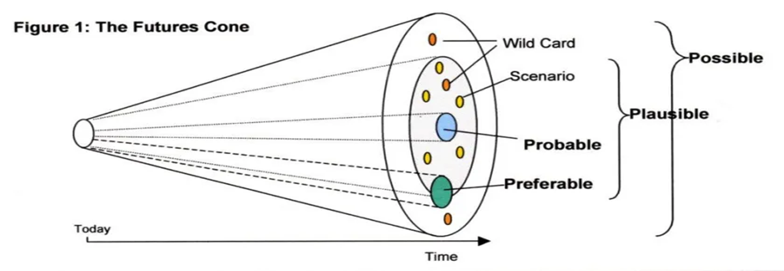
Scenario Development
The organization should have two or three scenario-based action plans ready during the year for implementation
Building a Scenario Plan is a group function. There are several ways to build effective scenarios but the most effective is the Cone of Possibility
9

Slide 12
Financial Sustainability Scenario
10

Slide 13
Scenario: Rural Sustainability
Reduced funding for rural clinics
Commitment to rural access
Current model loses money
11
Notes:
Frame mission vs margin tension.

Slide 14
Leadership Analysis
What does 'keeping clinics open' mean?
What must remain local?
What can be centralized or shared?
12
Notes:
Encourage network thinking.

Slide 15
Decision Focus
Hub-and-spoke models
Shared services and centralization
Virtual care and regional staffing
Redefined onsite scope
13
Notes:
Focus on efficiency.

Slide 16
Q+A

